Slide 1


HACK TO FUTURE 2.0
Problem
Statement - 1
By Team: Nobodies (HFA06)

Slide 2

Solution Title:
Anonymized Analysis Powered by Ethical Machine Learning

Slide 3

Summary
The solution focuses on ethically employing machine learning to understand customer trends and behavior without compromising user privacy. By anonymizing user identities in large databases, the system ensures compliance with privacy rights while enabling valuable insights. This approach safeguards individual information, addressing concerns about data security and respecting user rights in the era of advanced analytics.
STATEMENT

Slide 4

Technology:
The planned technology stack for this solution involves using Python as the primary programming language due to its versatility in data processing and machine learning. Libraries such as pandas and scikit-learn will by utilized for data manipulation and anonymization techniques.
01
02
03
Database Handling
Encryption and Hashing
Training the ML Model
04
05
06
Graphing
Secure Access Controls and Regular Audits
Informed Consent and Education

Slide 5
Objective 1
Develop a machine learning framework to analyze customer trends and behaviors in a given data set.
Proposed
Objective 2
Maintain the highest standards of ethical data usage using layer-by-layer encryptions schemes such as RSA.
OBJECTIVES
Objective 3
Completely anonymize user’s private information from the data used to train the ML model.

Slide 6


Database
Handling
For testing this algorithm, we are using a static .csv file as our dataset. In a more realistic setting, a dynamic database will be used. We identify and encrypt the fields that must remain confidential to protect the users’ privacy.

Slide 7


Encryption
& Hashing
To encrypt the confidential data, we use an RSA algorithm encrypted using the public key to ensure that no one can access the data once its encrypted. The private decryption key is discarded. On top of that, to add another layer of safety, we are using hashing.

Slide 8
Training
the ML Model
After encrypting the unwanted data, we use 3000 data sets to train the ML model to guess probabilities of the given parameter. This wide range of data sets allows us to predict parameter values with high accuracy.

Slide 9
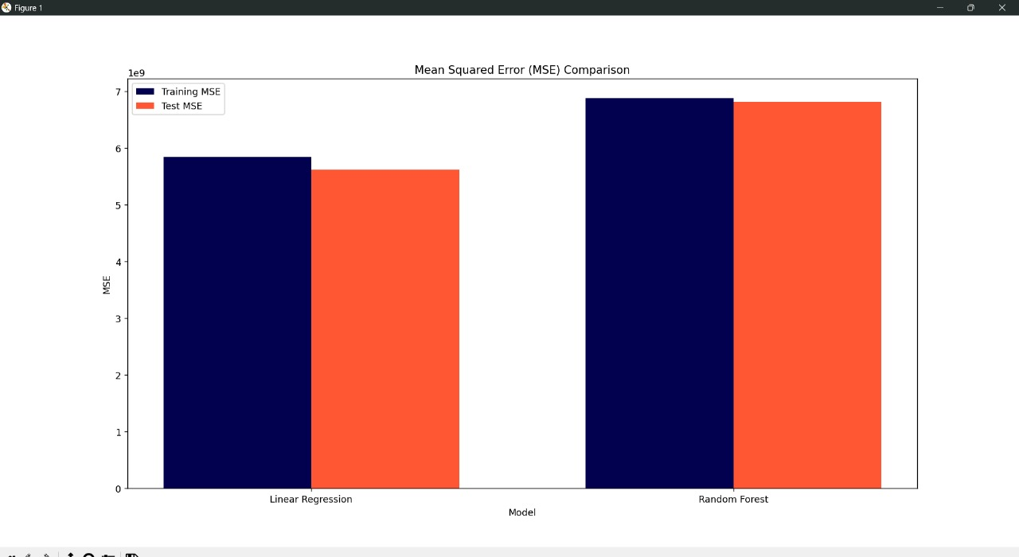
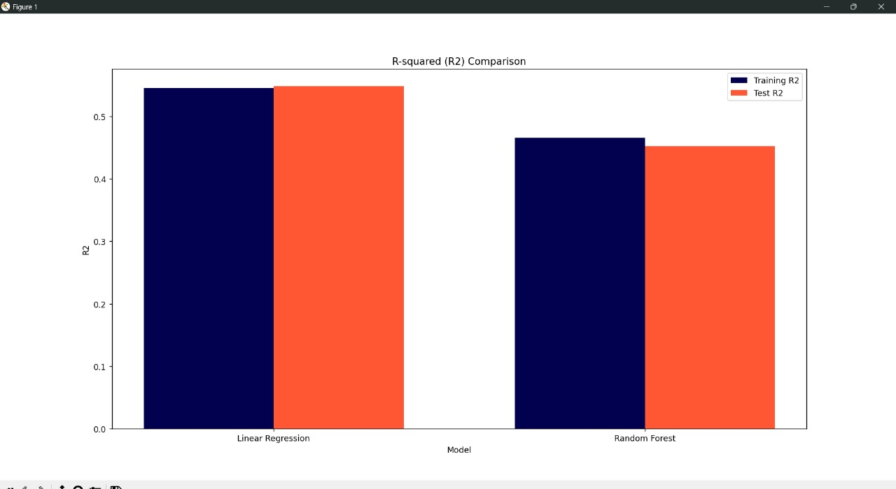
Graphing
We are using libraries such as matplotlib to generate graphical representation of the ML output and to check the accuracy of the algorithm.

Slide 10
Proposed Solution
Problem
Analyzing customer trends in extensive databases
We are using a ML algorithm trained on 3000 data sets to predict customer trends, further we are using graphing libraries to test the accuracy of the ML model with respect to ideal values.

Slide 11
Proposed Solution
Problem
Maintaining a high level of security
To keep private data confidential, we are using AES-GCM encryption on the user data. Further, we are implementing RSA to get a double layer encryption and then discarding the private key so that there is no scope of compromising data of the customer.

Slide 12
Proposed Solution
Problem
Maintaining transparency between the user and organization
Since the users are unaware of what their data is being used for, they may be hesitant to give it to the organization. So, are adding a user agreement to the front-end underlining what their data will be used for.

Slide 13

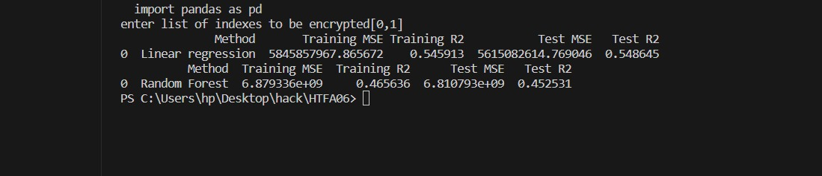
Final Code Output

Slide 14
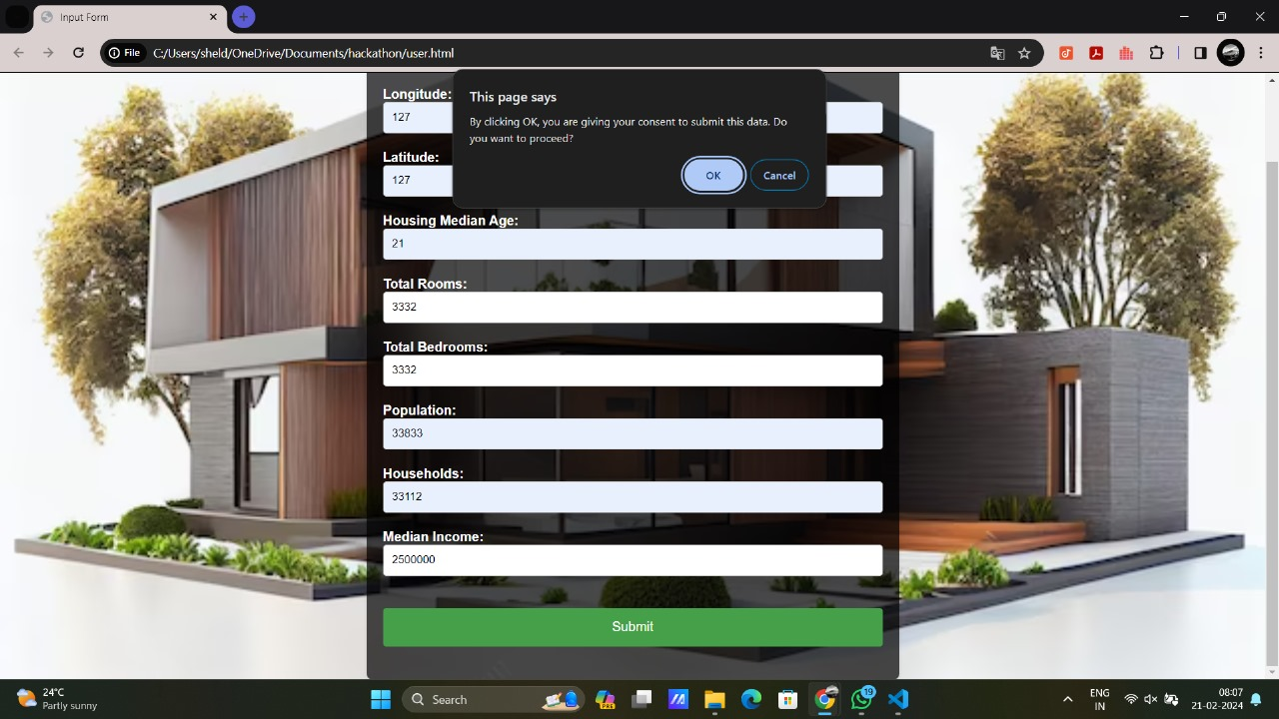
FRONT END

Slide 15
HACK TO FUTURE 2.0
THANK YOU

